Slide 1
Club management System
By:- Ajith Pai
Eskala Srekar
Kamal Kandula

Slide 2
Introduction
Club management system is a online portal for a college to manage all clubs online.
This is effective solution from hectic offline approach.
Efficient handling of numerous students at the same time.
Information and Registration procedure of events from every club on a single platform.

Slide 3
About
There are 4 pathways- Admin, Mentor, Office-bearer, Student.
Different users have different privileges and functions.
Admin coordinates the system.
Mentor oversees the club.
Office bearers take care of the club events and registrations.
Students view upcoming events and register to it.

Slide 4
Technology used
XAMPP
PHP
phpMyAdmin
HTML
SQL
Sublime text

Slide 5
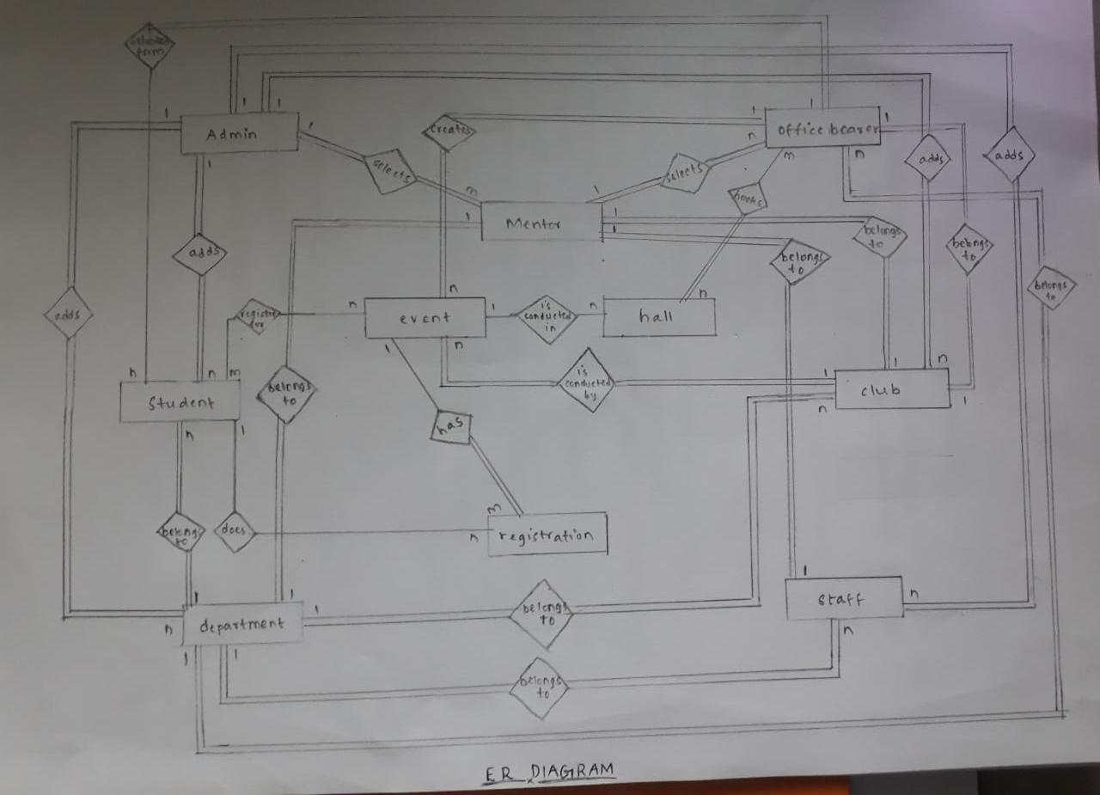
ER Diagram

Slide 6
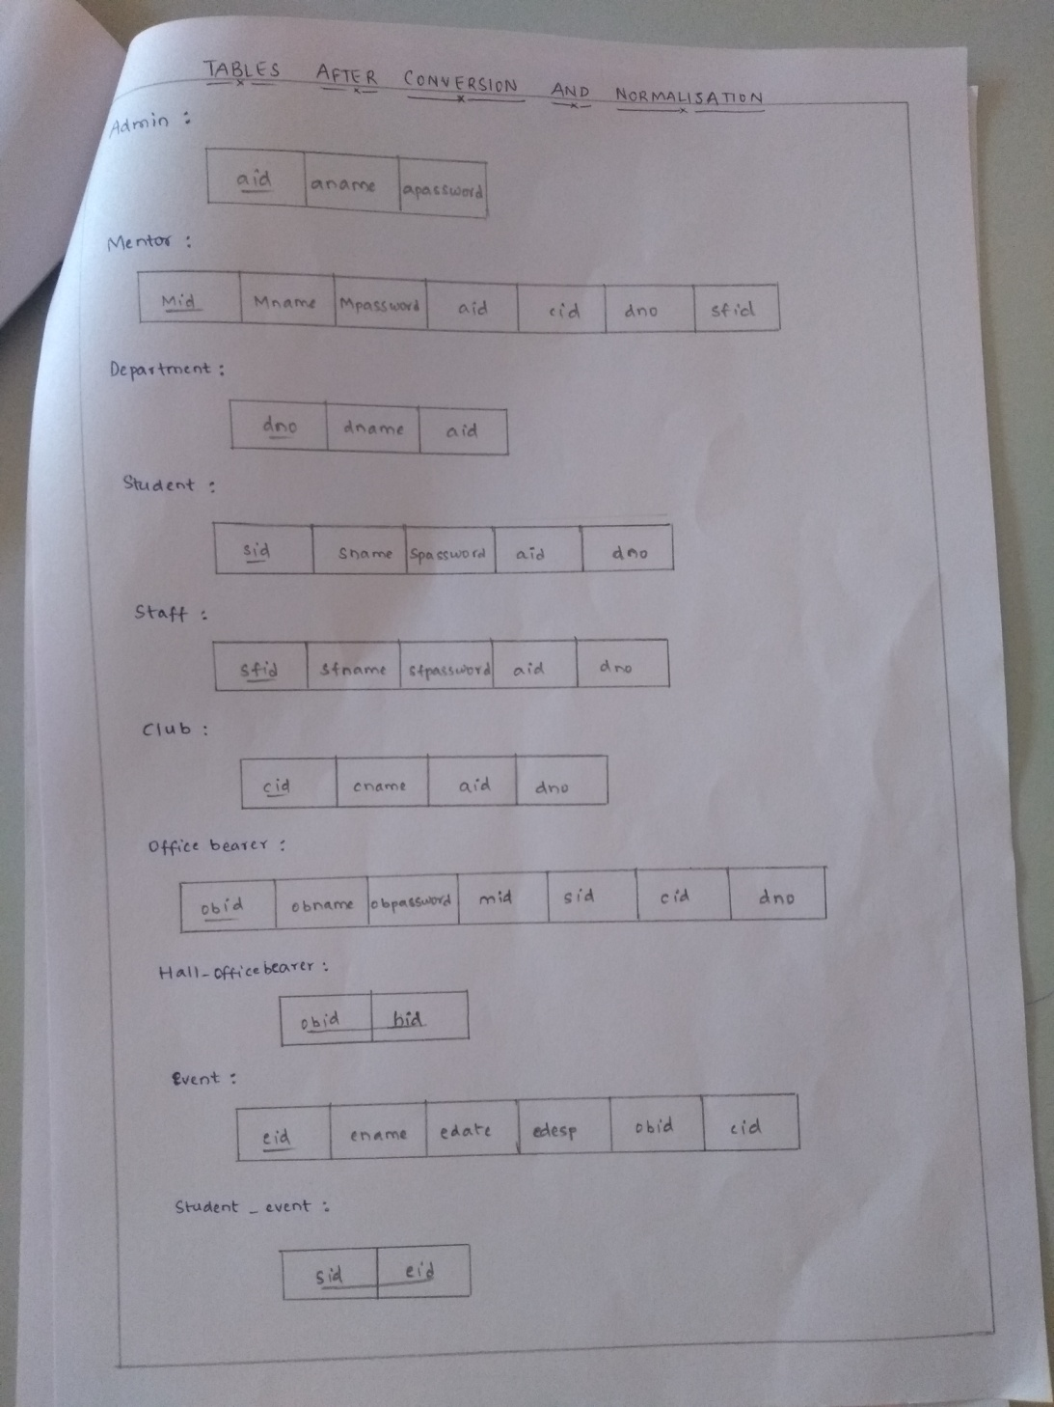
Table conversion

Slide 7
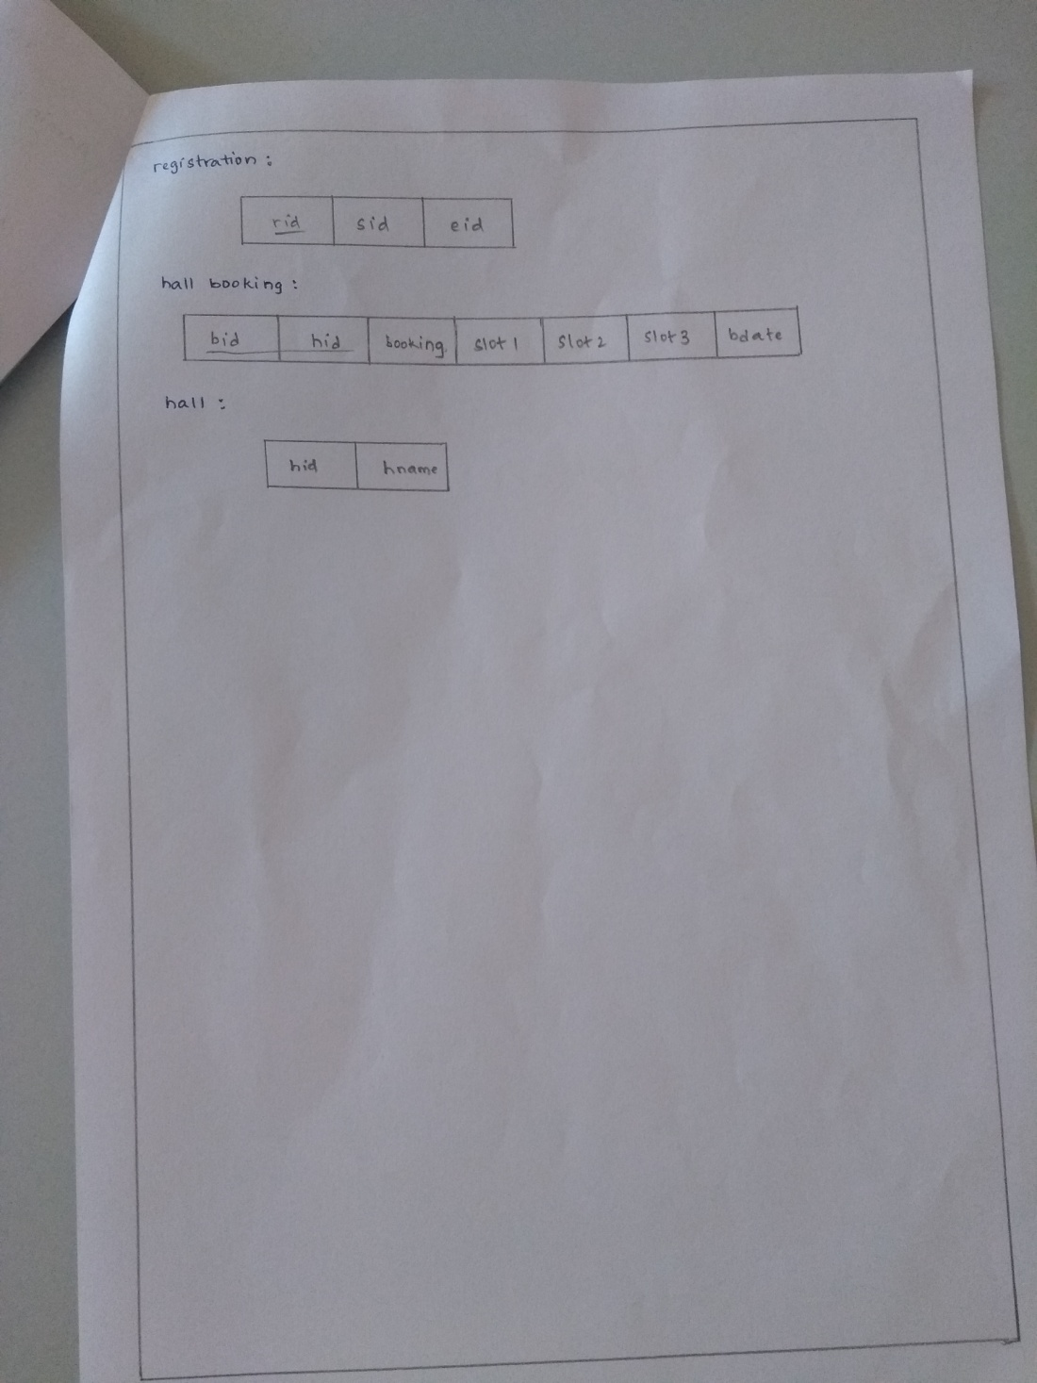

Slide 8
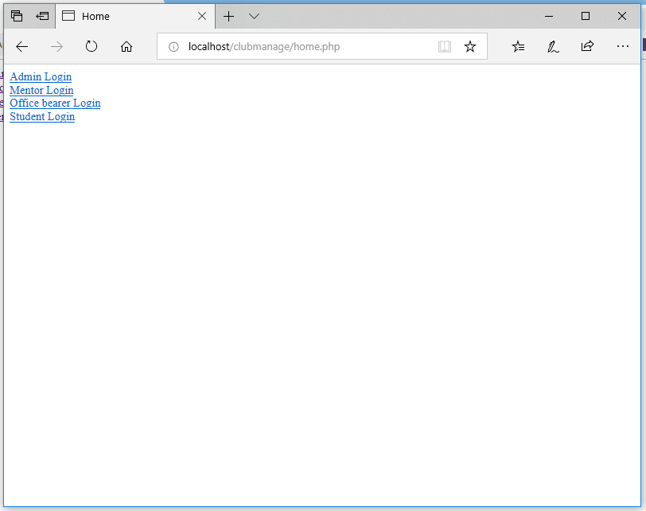
Module development

Slide 9
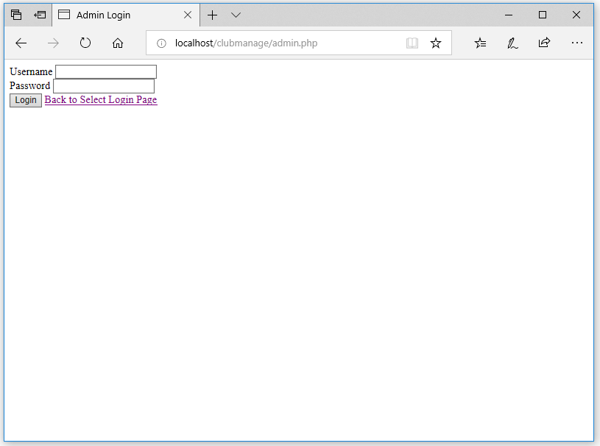

Slide 10
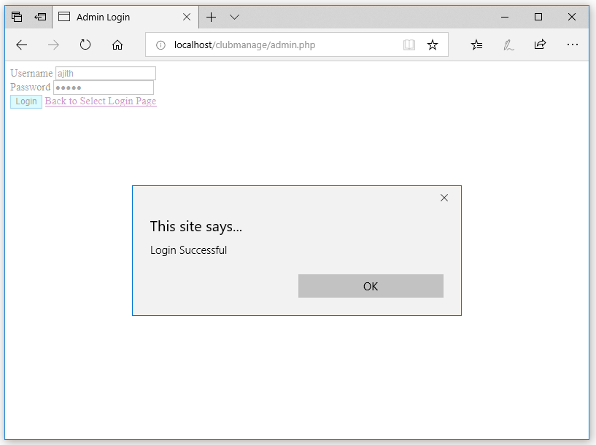

Slide 11
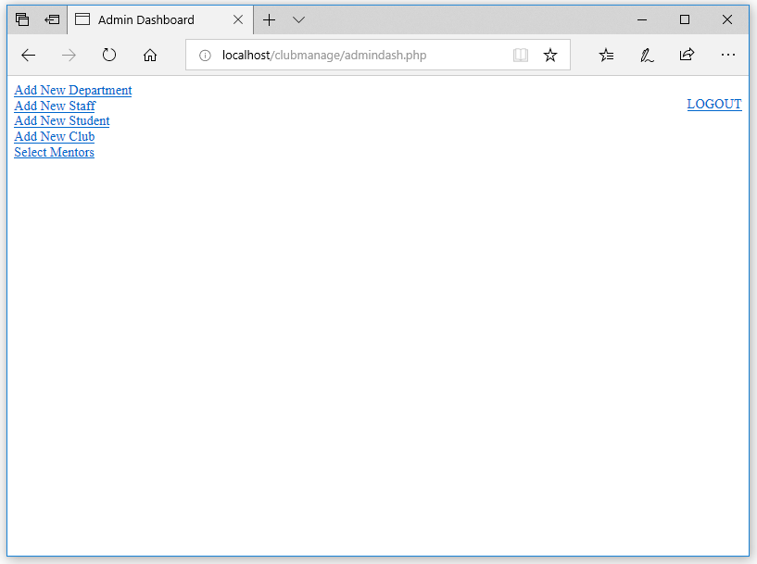

Slide 12
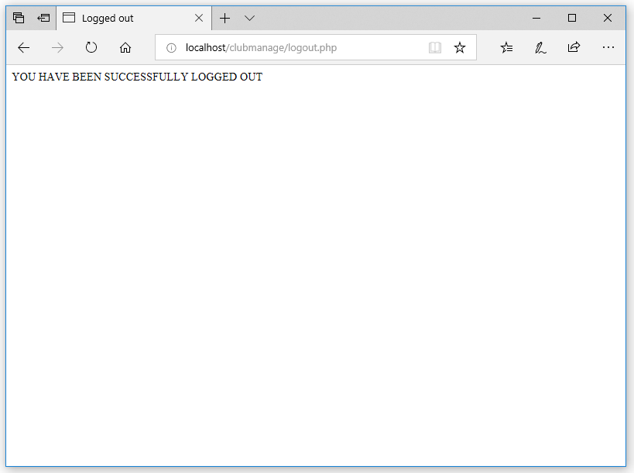

Slide 13
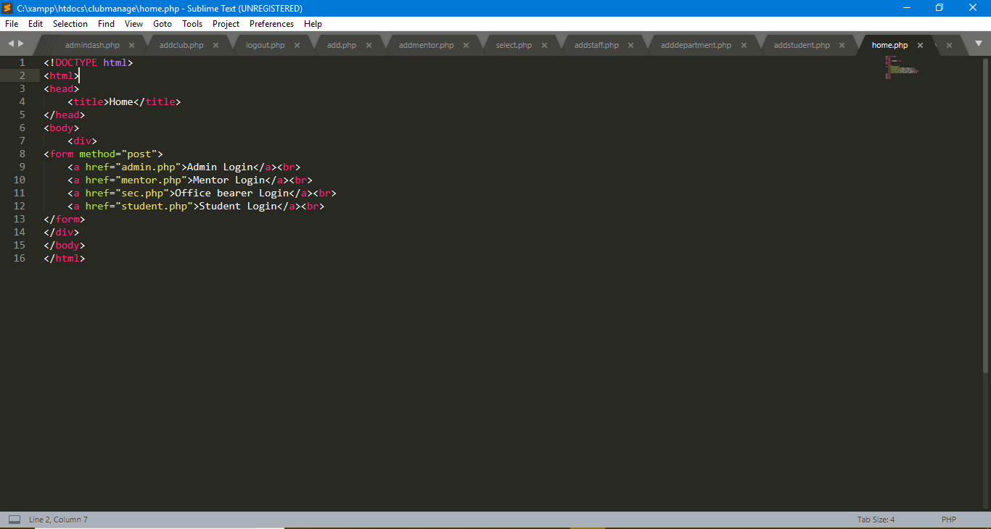
Backend code

Slide 14
DEMO
http://localhost/clubmanage/home.php

Slide 15
Thank you

